Slide 1



JustDrinks Ltd
View in Power BI
Last data refresh:
17/11/2025 11:34:41 UTC
Downloaded at:
17/11/2025 11:39:50 UTC

Slide 2
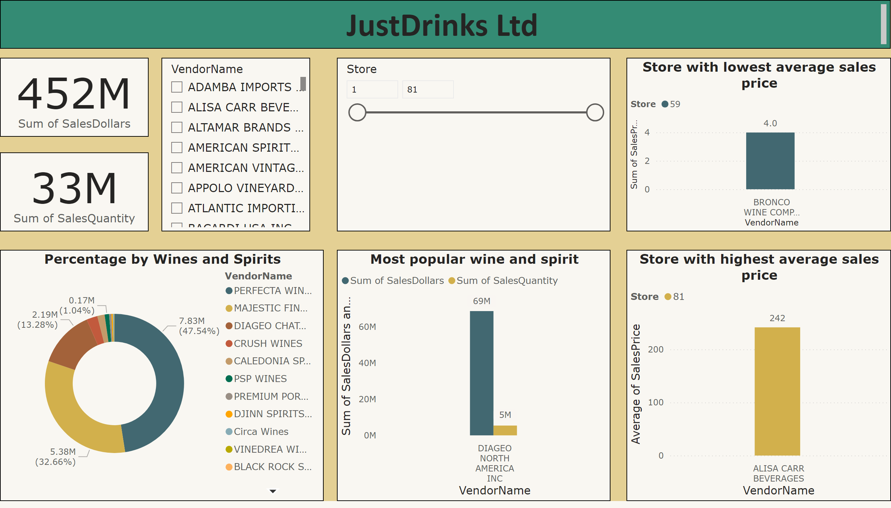
Section 1
Notes:
card
No alt text provided
card
No alt text provided
textbox
No alt text provided
Percentage by Wines and Spirits
No alt text provided
slicer
No alt text provided
Most popular wine and spirit
No alt text provided
Store with highest average sales price
No alt text provided
Store with lowest average sales price
No alt text provided
slicer
No alt text provided

Slide 3
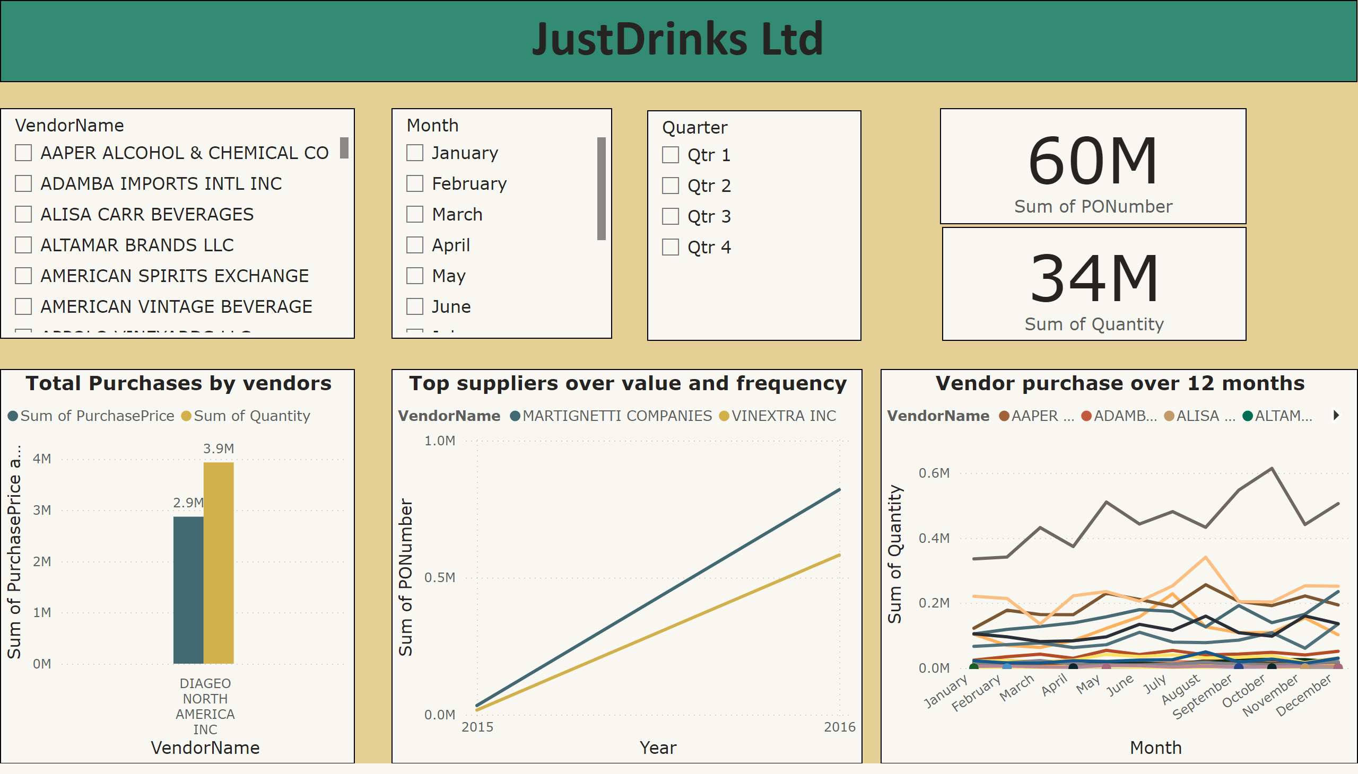
Section 2
Notes:
textbox
No alt text provided
Total Purchases by vendors
No alt text provided
Vendor purchase over 12 months
No alt text provided
Top suppliers over value and frequency
No alt text provided
slicer
No alt text provided
slicer
No alt text provided
slicer
No alt text provided
card
No alt text provided
card
No alt text provided

Slide 4
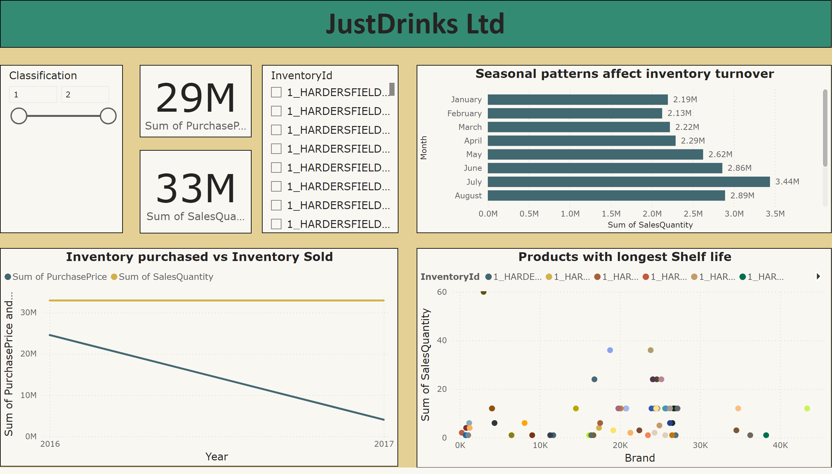
Section 3
Notes:
textbox
No alt text provided
Inventory purchased vs Inventory Sold
No alt text provided
Products with longest Shelf life
No alt text provided
Seasonal patterns affect inventory turnover
No alt text provided
slicer
No alt text provided
slicer
No alt text provided
card
No alt text provided
card
No alt text provided

Slide 5
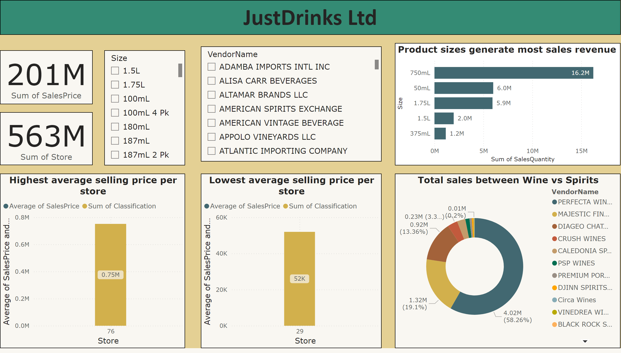
Section 4
Notes:
textbox
No alt text provided
Total sales between Wine vs Spirits
No alt text provided
Highest average selling price per store
No alt text provided
Lowest average selling price per store
No alt text provided
Product sizes generate most sales revenue
No alt text provided
card
No alt text provided
card
No alt text provided
slicer
No alt text provided
slicer
No alt text provided

Slide 6
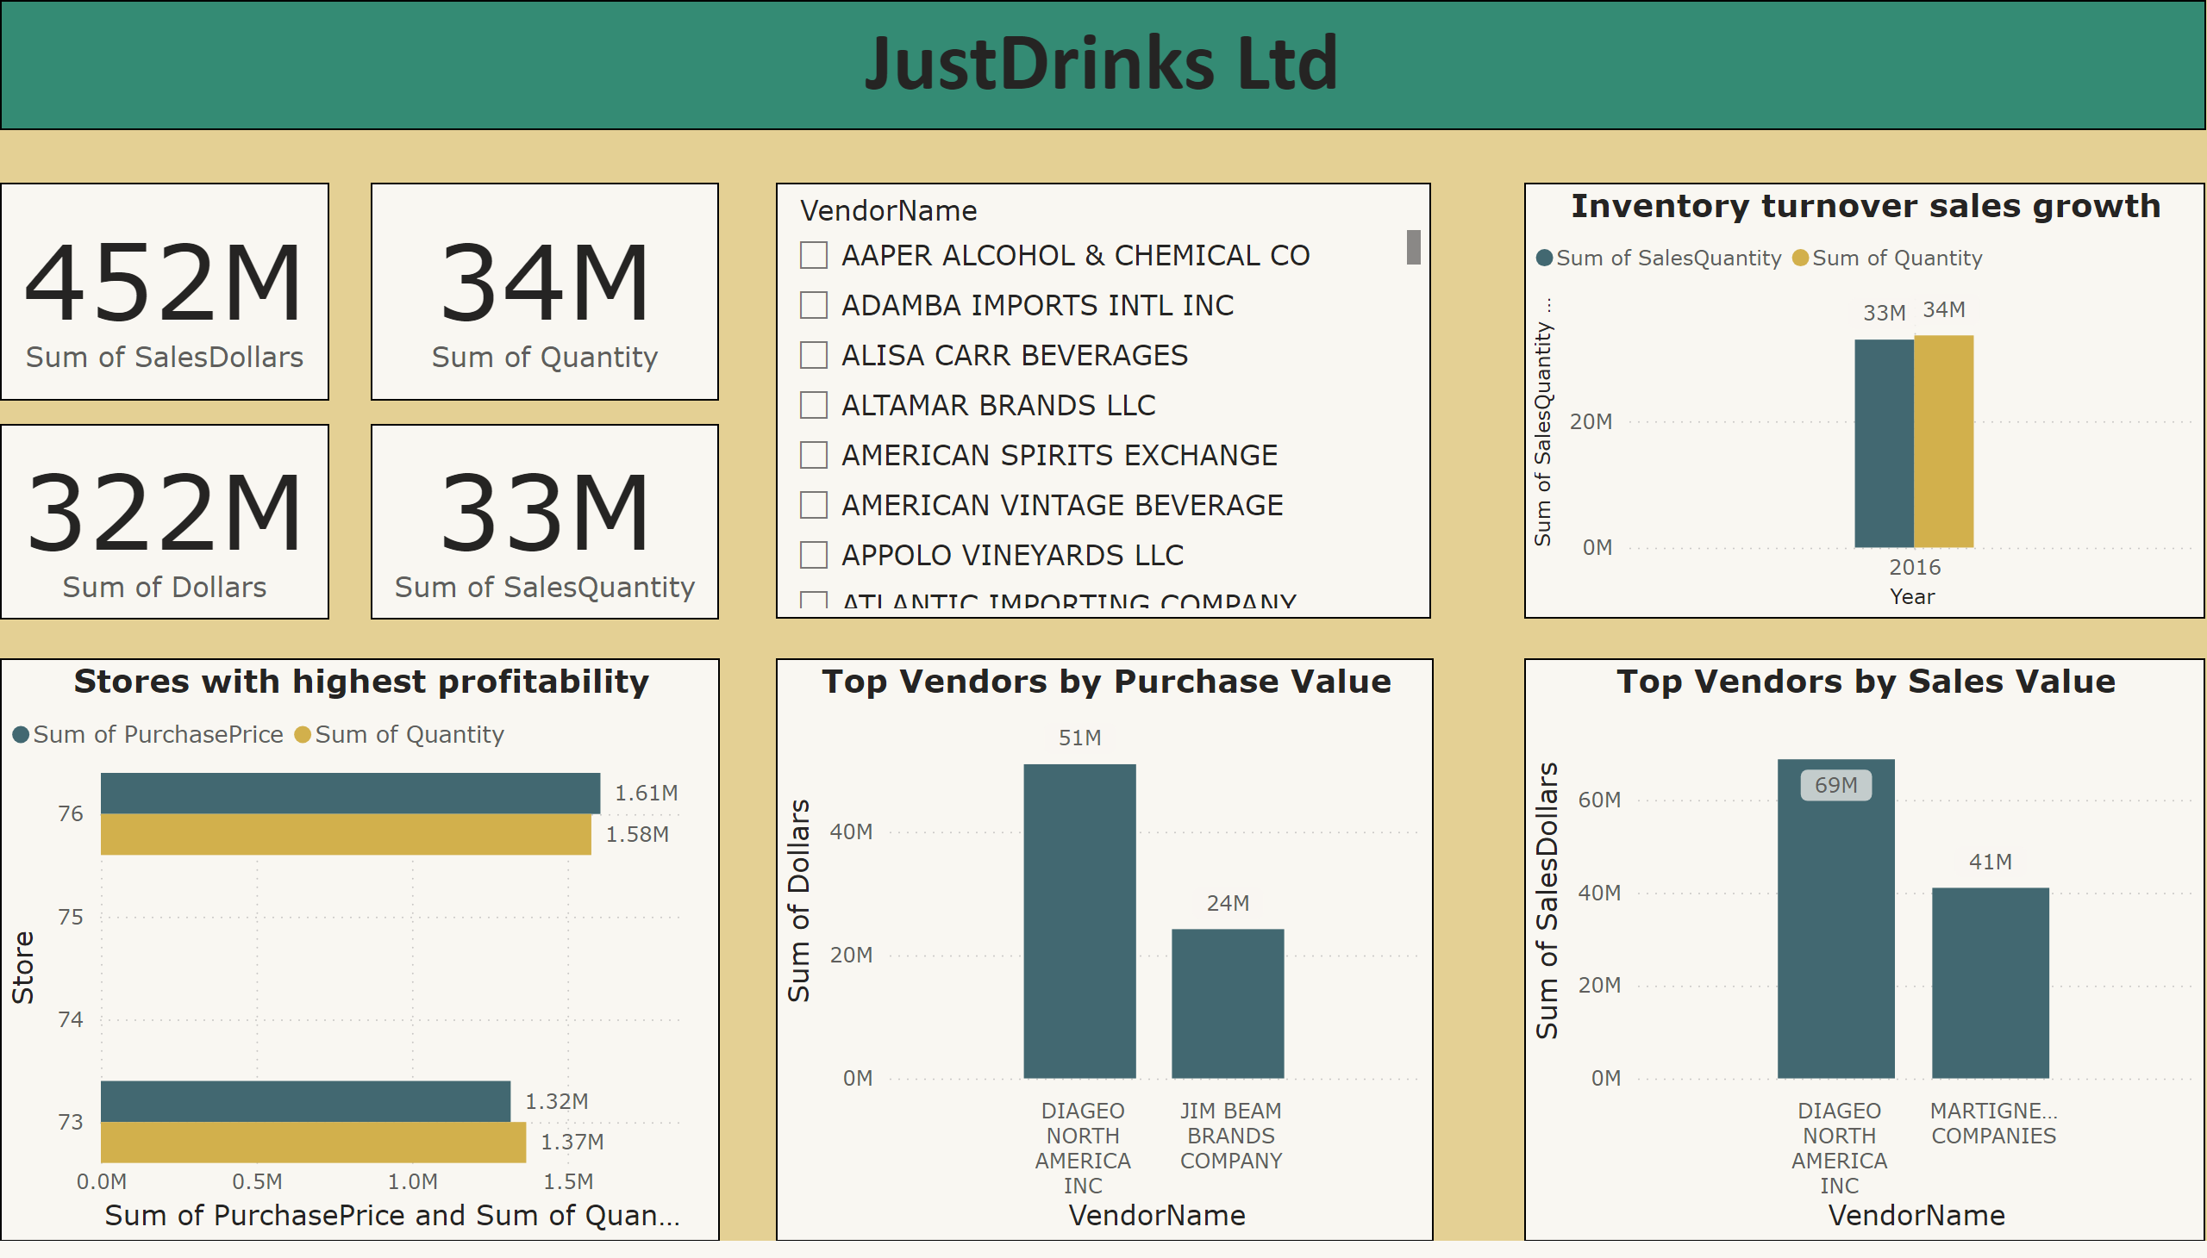
Section 5
Notes:
textbox
No alt text provided
Stores with highest profitability
No alt text provided
Top Vendors by Purchase Value
No alt text provided
Top Vendors by Sales Value
No alt text provided
Inventory turnover sales growth
No alt text provided
card
No alt text provided
card
No alt text provided
slicer
No alt text provided
card
No alt text provided
card
No alt text provided

Slide 7
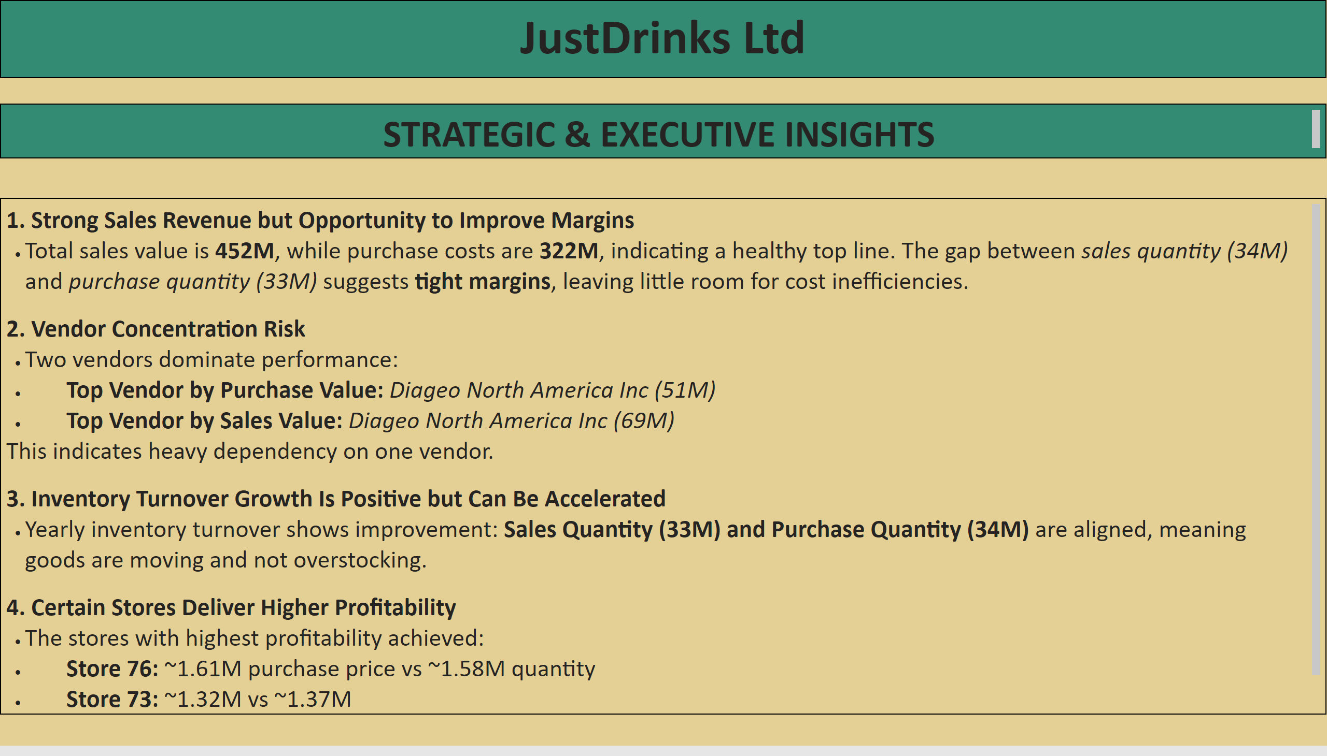
5c) Executive Insights
Notes:
textbox
No alt text provided
textbox
No alt text provided
textbox
No alt text provided

Slide 8
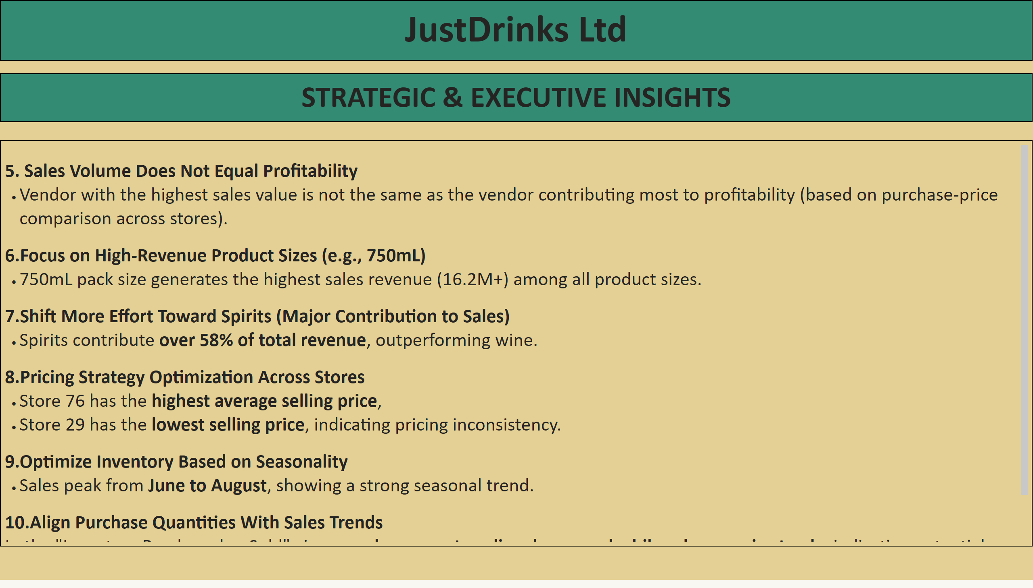
5c) Executive Insights
Notes:
textbox
No alt text provided
textbox
No alt text provided
textbox
No alt text provided

Slide 9
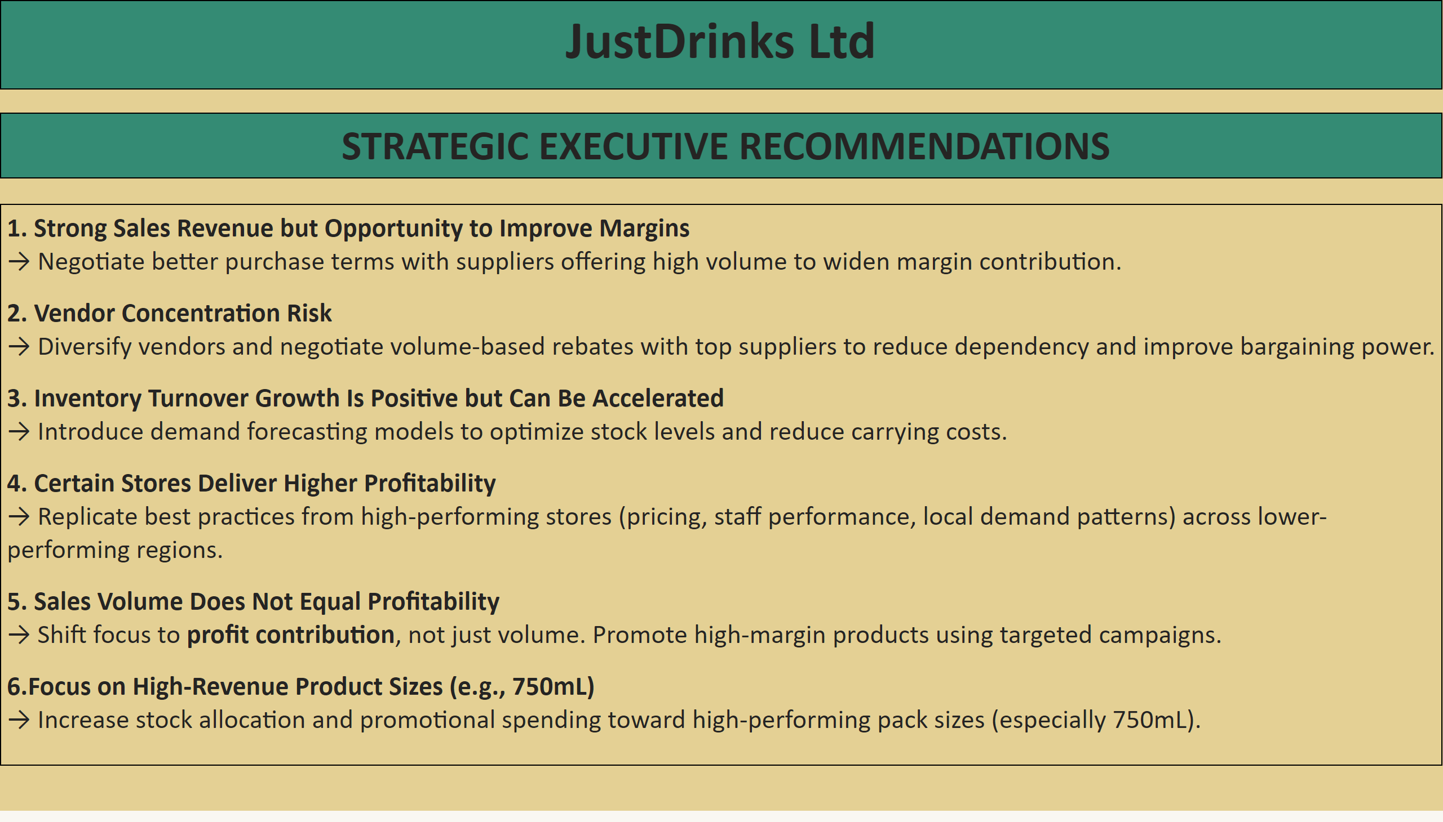
Recommendations
Notes:
textbox
No alt text provided
textbox
No alt text provided
textbox
No alt text provided

Slide 10
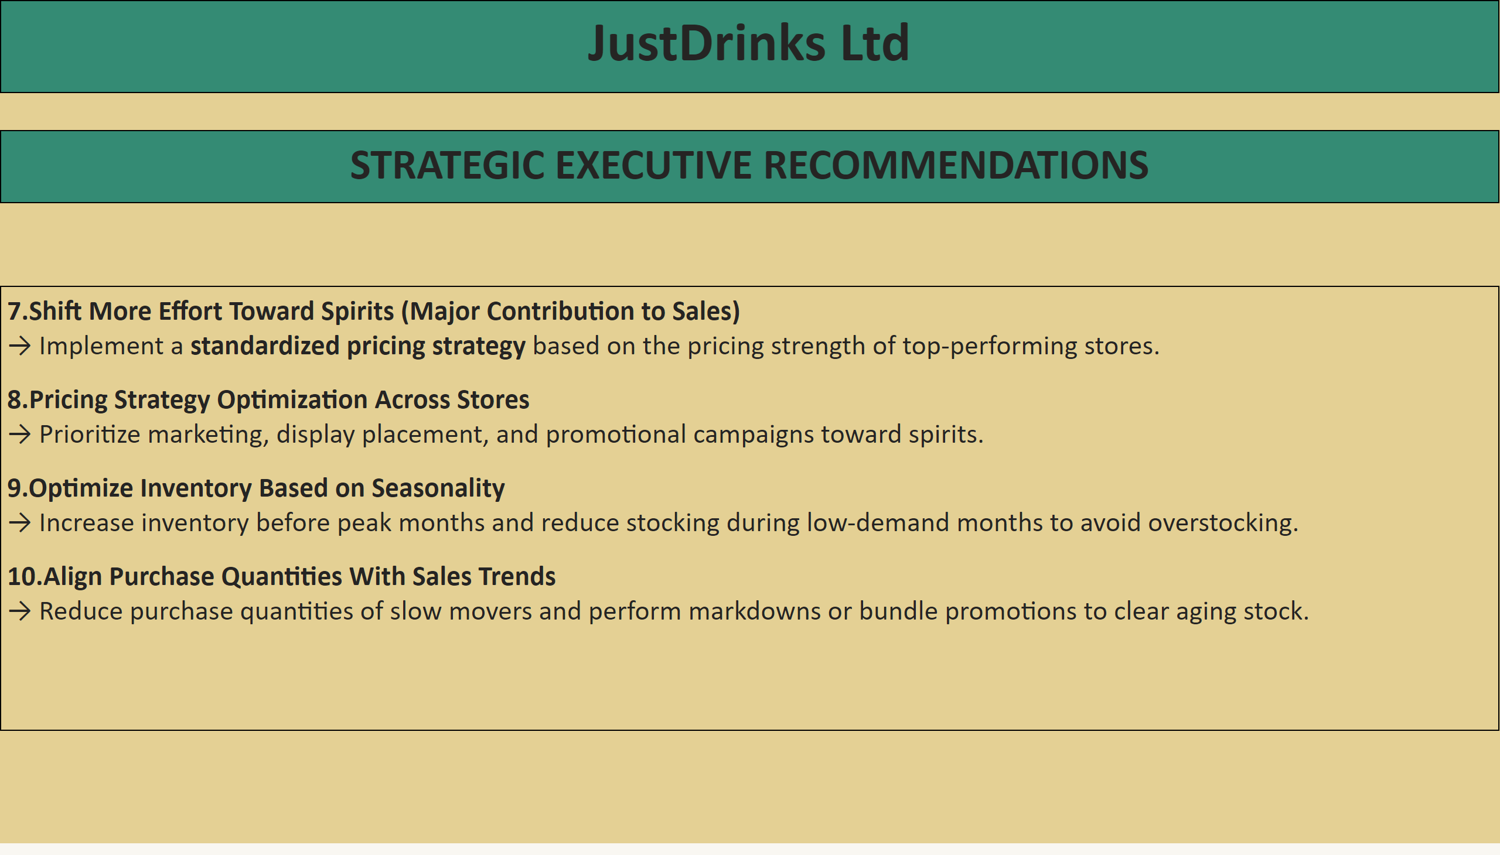
Recommendations
Notes:
textbox
No alt text provided
textbox
No alt text provided
textbox
No alt text provided

Slide 11
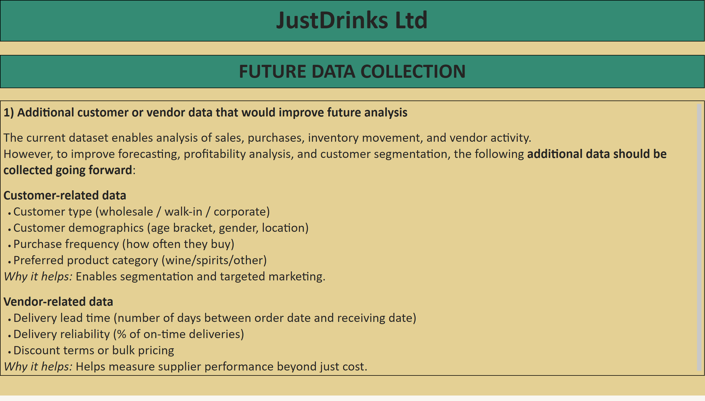
Section 6
Notes:
textbox
No alt text provided
textbox
No alt text provided
textbox
No alt text provided

Slide 12
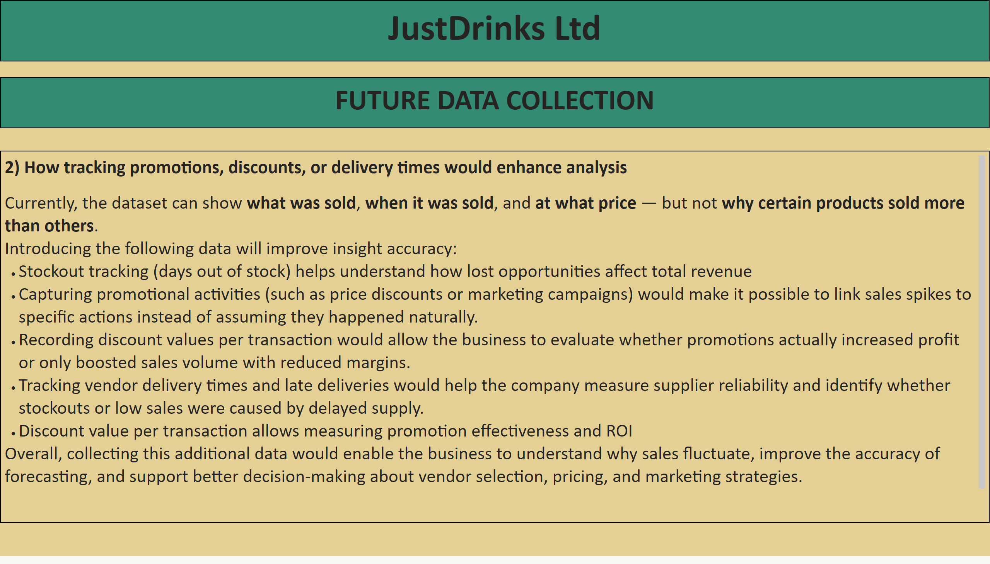
Section 6
Notes:
textbox
No alt text provided
textbox
No alt text provided
textbox
No alt text provided

Slide 13
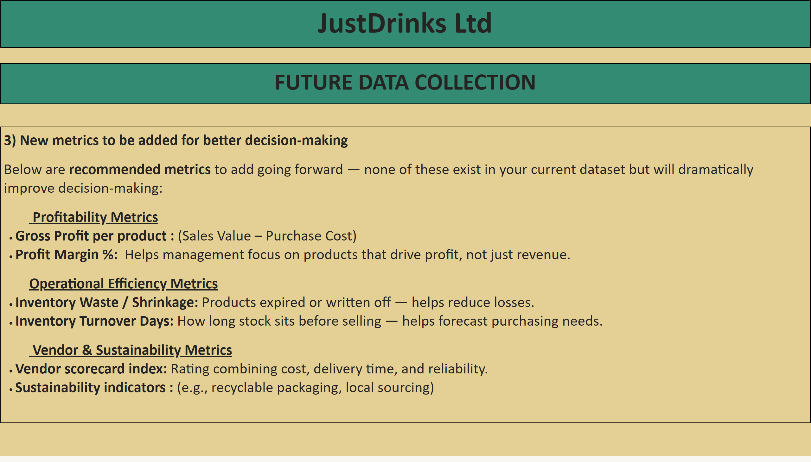
Section 6
Notes:
textbox
No alt text provided
textbox
No alt text provided
textbox
No alt text provided

Slide 14
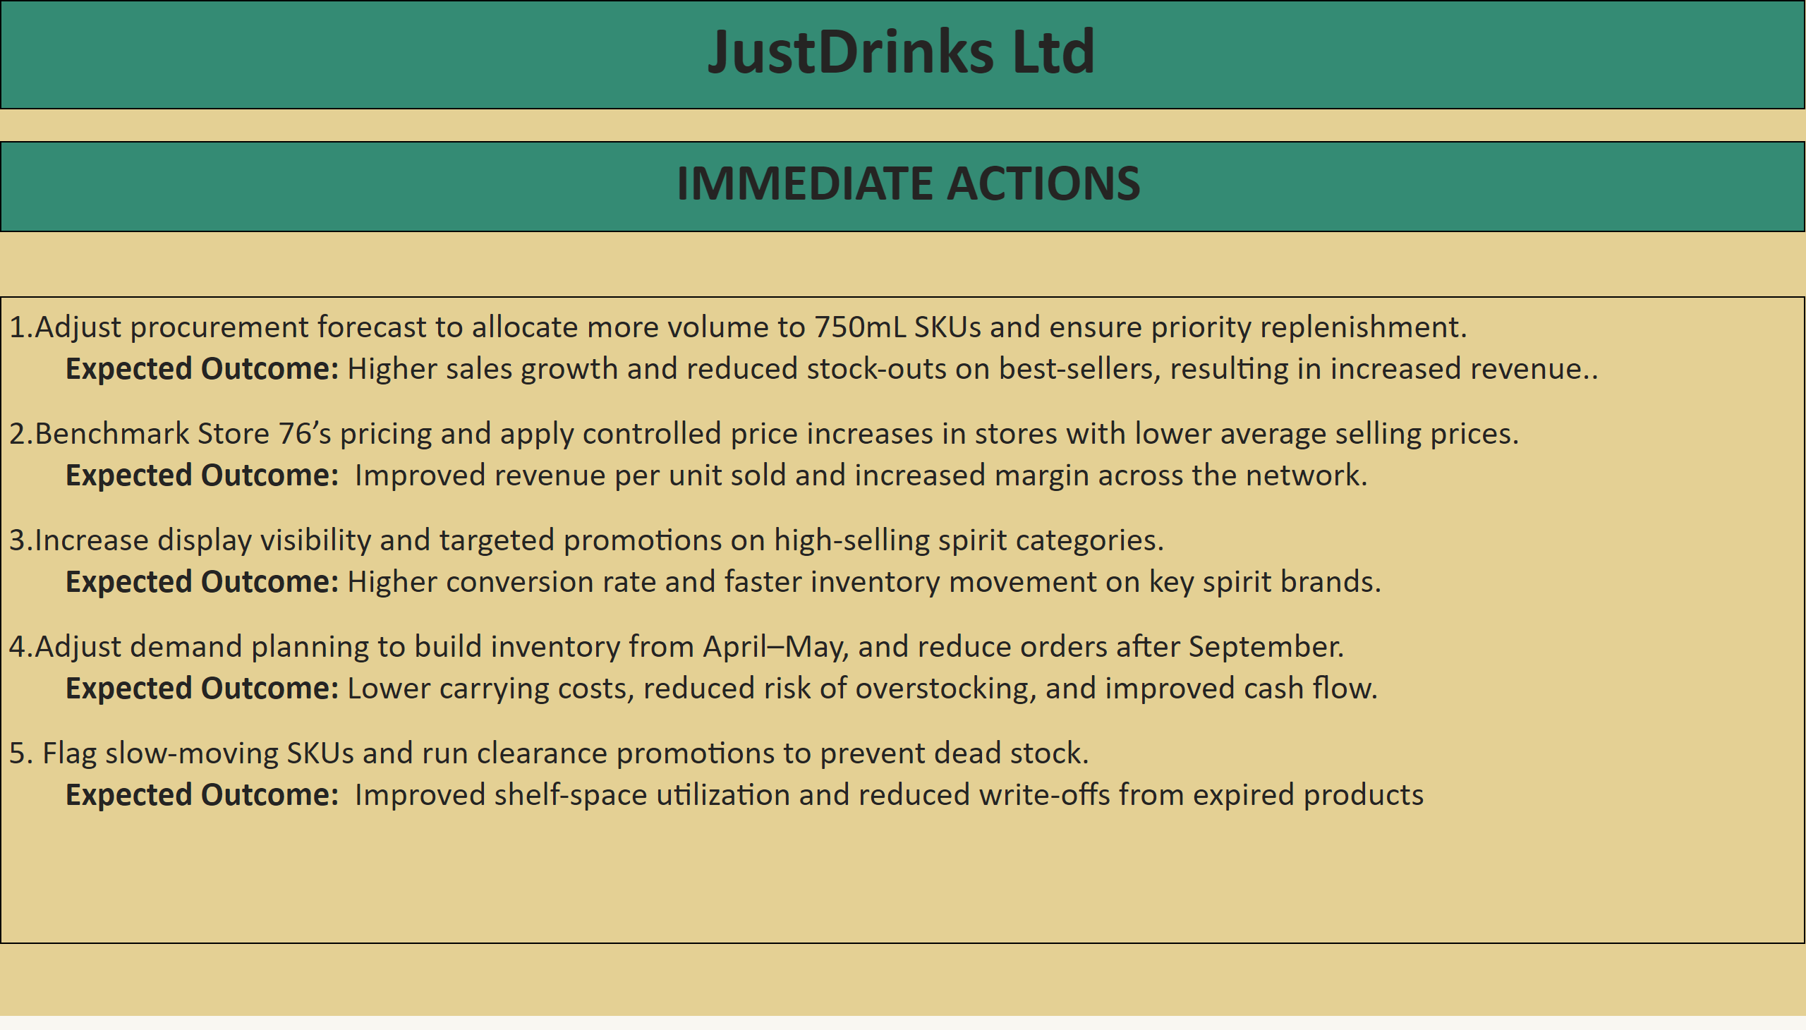
Immediate actions
Notes:
textbox
No alt text provided
textbox
No alt text provided
textbox
No alt text provided

